Slide 1
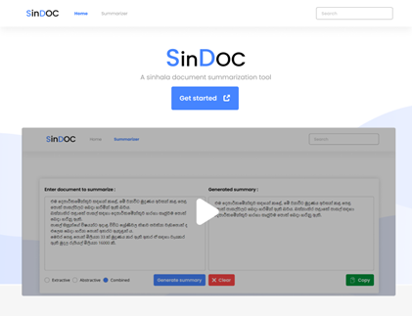
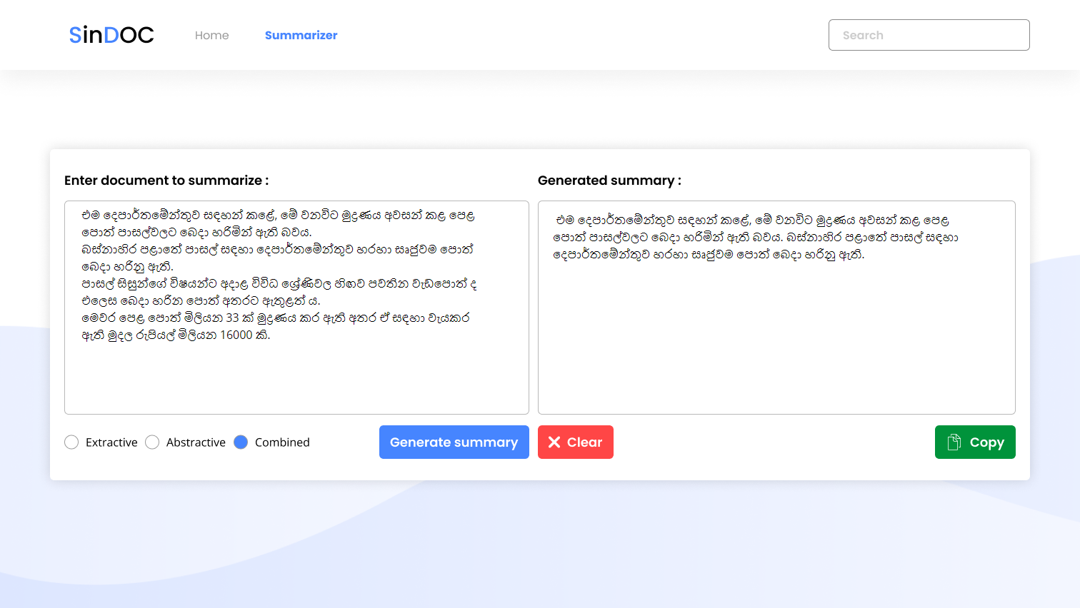
SinDOC: A Combined Approach of Summarizing Low Resource Sinhala Language Documents
Mohamed Hamza Ziyard
Supervised by Mithushan Jalangan

Slide 2
Table of contents
01
02
03
04
Problem Domain
07
Testing & Evaluation
Research Gaps
08
Contribution to BOK
Research Aim
09
Novelty
System Design
10
Limitations & Future enhancements
05
Technology Stack
11
Conclusion
06
Demo
12
Research papers

Slide 3
01
Problem domain

Slide 4
Problem Domain
(a) Low resource language
Languages that have less resources within the internet are known as low resource languages (Hasan et al., 2021).
Sinhala language is the chosen low resource language
(b) Summarization
Identifying the most important content of a document and simplyfying them without loosing the meaning of it is known as summarization (Gonçalves, 2021)

Slide 5
Why Sinhala language documents
Sinhala is the primary language of Sri Lankans.
According to Digital 2022: Sri Lanka (2022) 11.5 million (~60%) Sri Lankan population use the internet and it is predicted to be increased massively by the year of 2023.
Less researched in summarization domain

Slide 6
Summarization
Longer documents
Summaries
Extractive – Extracts the most important sentences and return them
Abstractive – Extracts the most important sentences and paraphrase them as human generated
Combined – Uses both extractive and abstractive techniques

Slide 7
02
Research Gaps

Slide 8
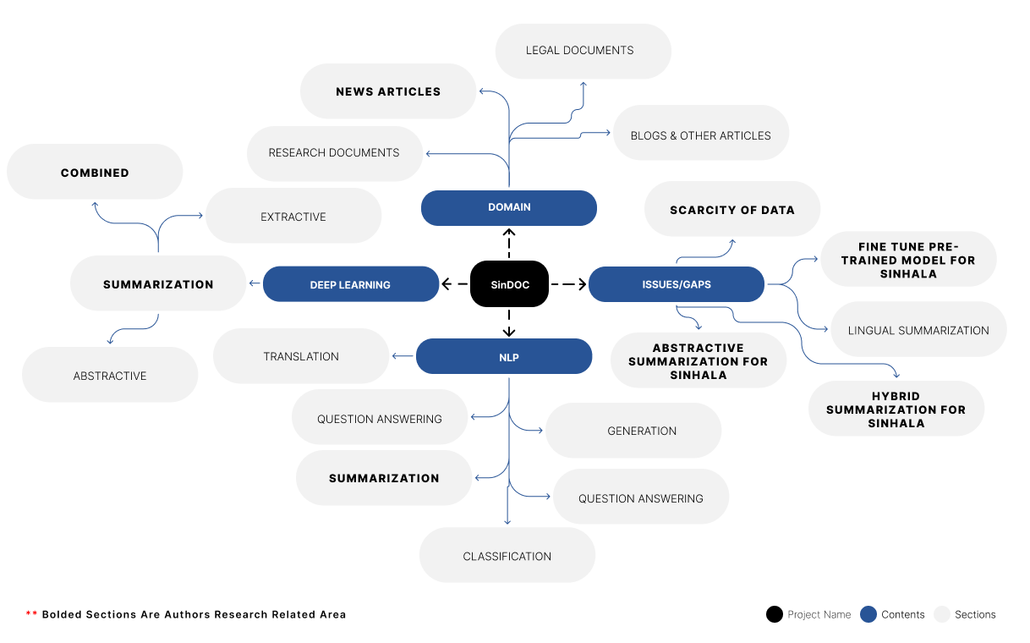

Slide 9
Research Gaps
(a) Sinhala document summarization tool with a combined approach. (Hasan et al., 2021)
(b) A dataset for Sinhala summarizer (Dhananjaya et al., 2022)
(c) Summarizer with no text limit as an input (Subramanian et al., 2020)

Slide 10
03
Research Aim

Slide 11
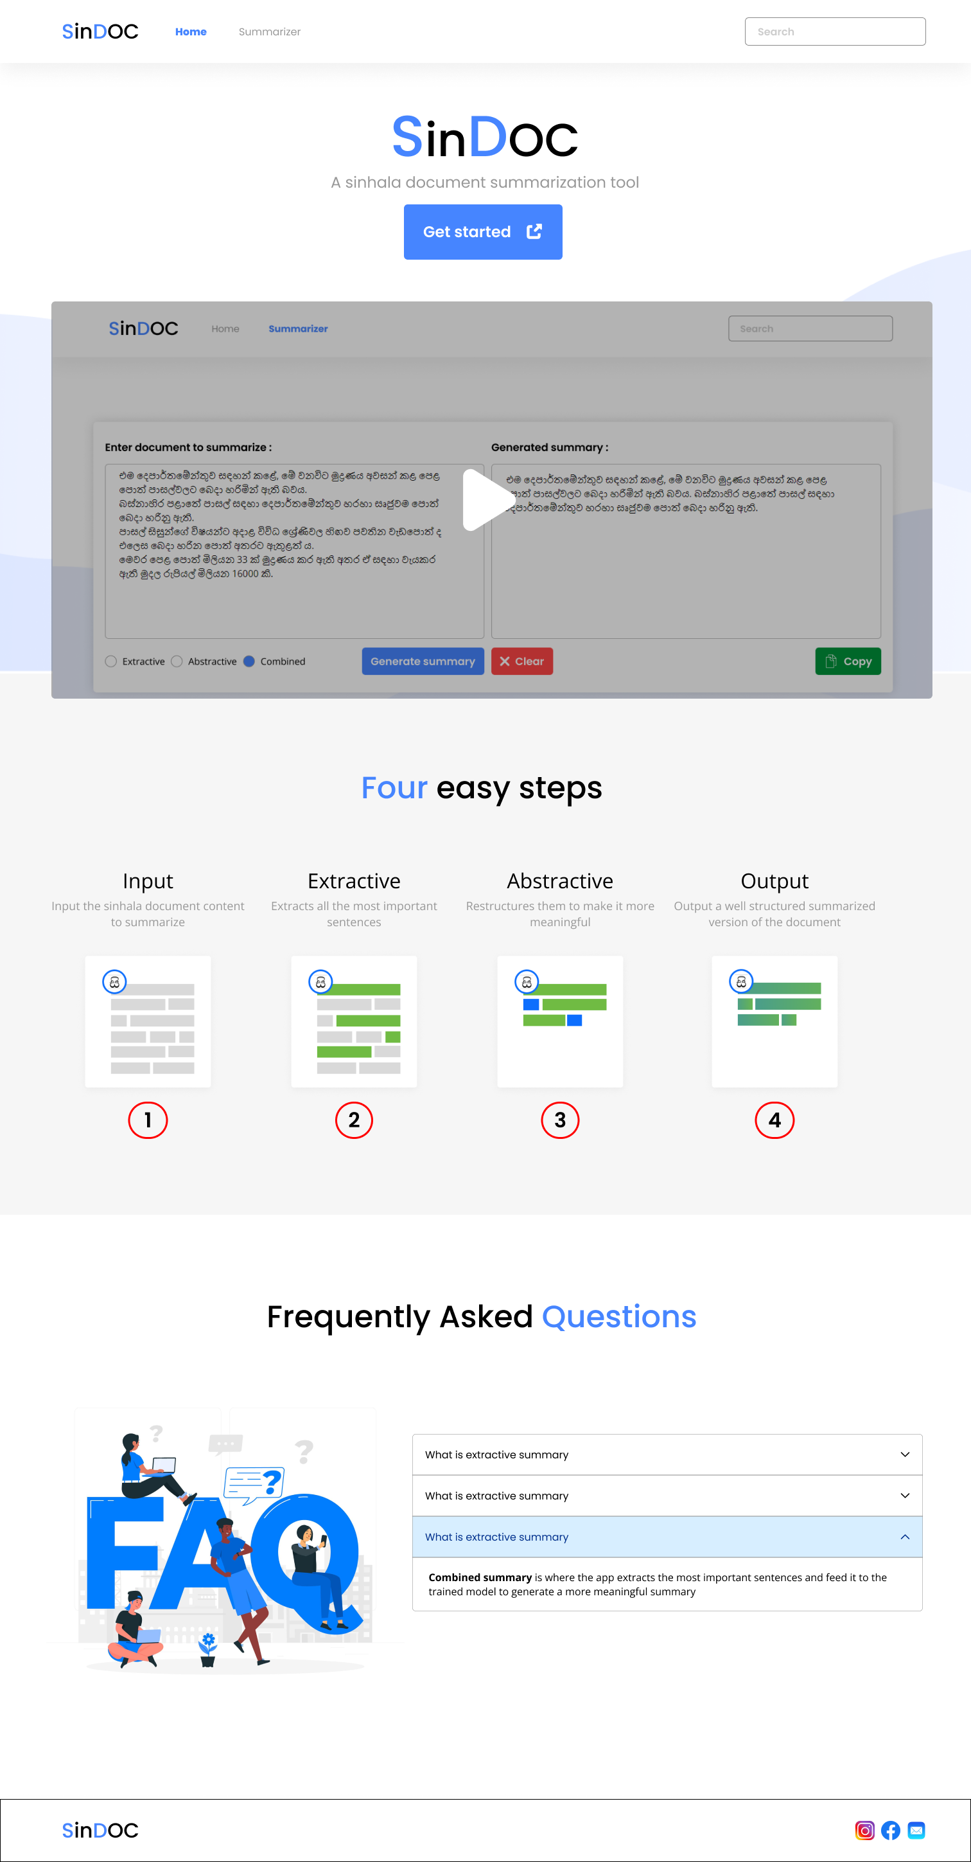
Aim
The aim of this research is to design, implement and evaluate a system that does document summarization for a Sinhala document or article’s content and provide a summary of it

Slide 12
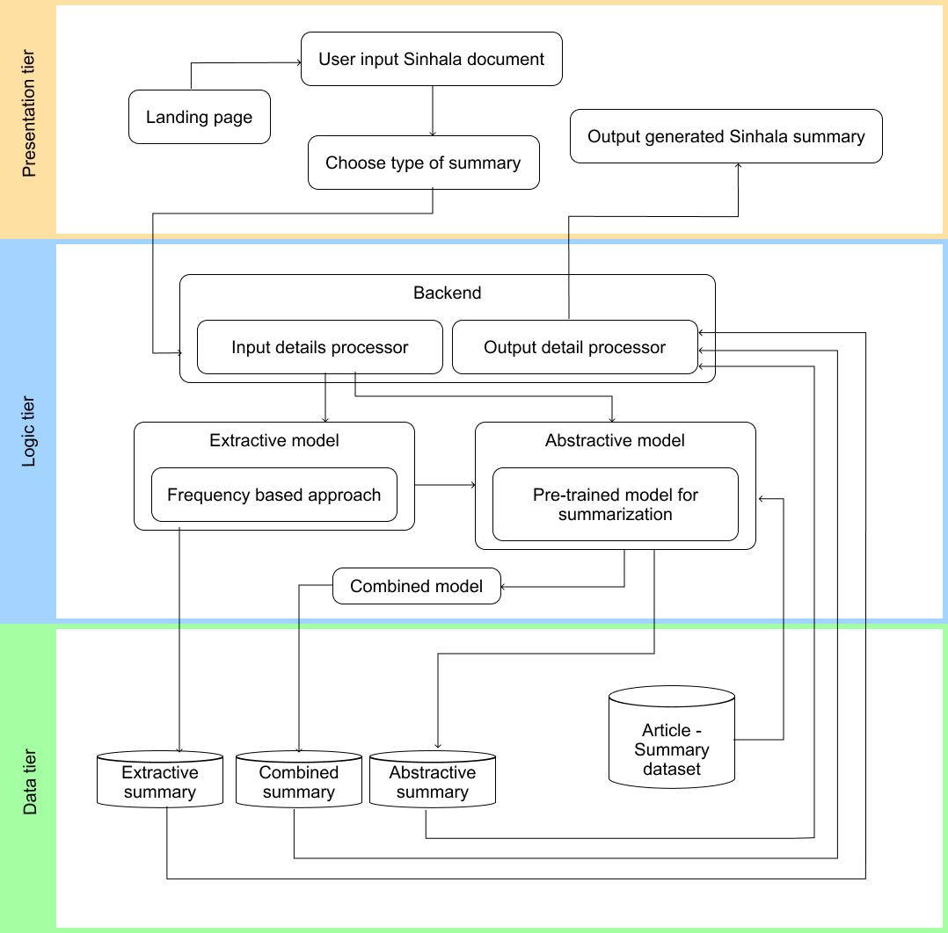
04
System Design

Slide 13
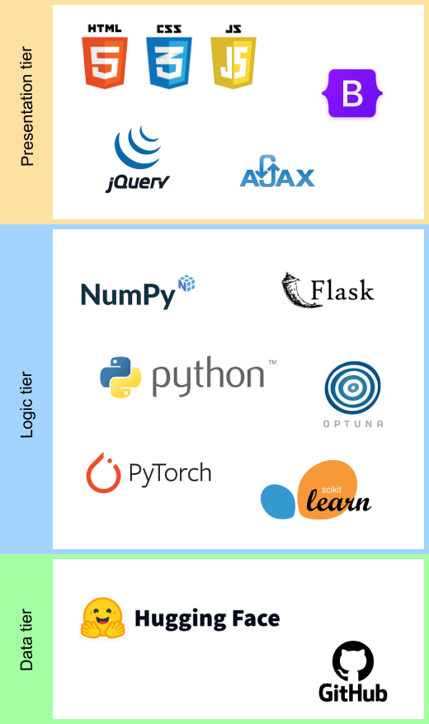
05
Technology Stack

Slide 14
06
Demo of the prototype

Slide 15
07
Testing & Evaluation

Slide 16
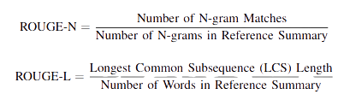
Automatic Evaluation
(a) ROUGE metric
(b) BLEU metric

Slide 17
ROUGE results on BBC summary test dataset
 | multilingual XLSUM (Hasan et al., 2021) | Ours Abstractive | Ours Hybrid
ROUGE-1 | 27.290 | 58.7512 | 60.2513
ROUGE-2 | 13.3815 | 26.3214 | 27.3521
ROUGE-L | 23.4699 | 35.5231 | 34.2135
*********************************************************************************************************************************
It is important to note that the SOTA model used for benchmarking haven’t stated their method of testing. They have just provided the score stating that it is from their test data. Due to time constraints the I had to pick ten random summaries from the test dataset and generate the above-mentioned ROUGE scores. Due to this the results provided above may not be fully accurate and reliable.
*********************************************************************************************************************************

Slide 18
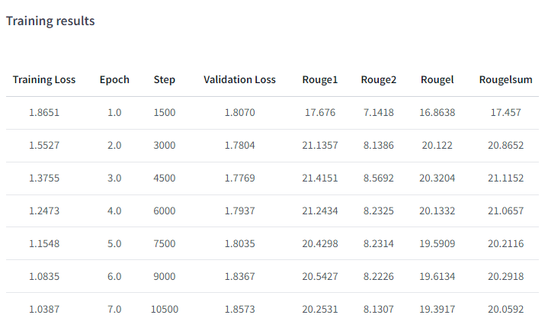
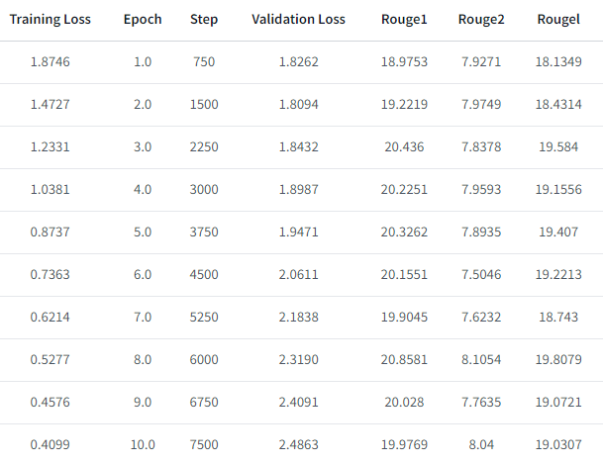
Automated VS. SOTA paramaters training results
Batch size - 4
Batch size - 8

Slide 19
Human Evaluation
Technical (4) | Surge Global (Data Scientist) ZorroSign (Anonymous) Calcey (SSE) IFS (UI/UX Designer) | Good research area to work on with. Automating training argument generation makes training much easier and faster. Hybrid system makes the application better Model is still not as good as English but does solve the aim appropriately. Improve the model with a better accurate and well-crafted dataset Train the model on various another domain dataset Improve app speed
Domain (3) | Zahira (O/L Sinhala teacher) Zahira (A/L Sinhala teacher) Anonymous (News Department) | The results generated from the application are almost grammatically correct. Only in certain cases does the model feed old data to the user. Having an extractive approach was a good way of patching such issues. Improve app speed
Focus group (6) | Vetstoria (ASE) Sysco Labs (SE) DxDy– (ASE) HSenid Lanka (ASE) Enterprise Analytics (ATC) DxDy (Intern UI/UX Designer) | Summary generation was meaningful in most cases. Option of choosing the type of summary to be generated improves the reliability Summary results perform well for news data. Improve app speed

Slide 20
08
Contribution to BOK

Slide 21
Contribution to Problem Domain | Contribution to Research Domain
Generate Sinhala summaries for long Sinhala documents | Automating generation of training arguments provide better results
Maintain documents highlights in summary | Combined approach for Sinhala summarization
Reduce the time consumed for reading long Sinhala articles/ documents | Translated sub-dataset of CNN dataset
 | All models and dataset are publicly available

Slide 22
09
Novelty of the research

Slide 23
First Combined approach for Sinhala document summarization
Proof that automation of training arguments provide better results for Abstractive model
No input text limit for application
Proof that translated dataset doesn’t affect app quality

Slide 24
10
Limitations and Future Enhancements

Slide 25
Limitations
(a) Training arguments had to be reduced due to the lack of computational resources (More GPU consumption)
(b) ROUGE testing isn’t fully reliable for LR languages (Hasan et al., 2021)
(c) Limited benchmarking models
(d) Dataset used is specific for news domain

Slide 26
Future enhancements
(a) Use the model for other NLP tasks (Liu and Lapata, 2019)
(b) Q&A system within the model (Zhang, Wei and Zhou, 2019)
(c) Improve model with real Sinhala summary dataset
(d) Improve model for other problem domains
(e) Improve speed of summary generation

Slide 27
11
Conclusion

Slide 28
Challenges faced
(a) Scarcity of Sinhala datasets
(b) Identifying pre-trained models that perform well for Sinhala summarization
(c) Lack of computational resources
(d) Difficulty in contacting foreign evaluators
Existing skills | Skills learnt
Full stack development | NLP for Sinhala
UI/UX and Accessibility | Summarization
 | Use of pretrained models

Slide 29
12 Research Papers
International Conference on Computer Science & Software Engineering (CSSE 2023) Status – Accepted, Awaiting payment
International Journal of Novel Research and Development (IJNRD) Status – Accepted, Awaiting payment
Global Scientific Journals (GSJ 2023) Status – Accepted, Awaiting payment
Microsoft CMT (CLNLP2023) Status – In-review
Researchgate (Pre-print) Link Status – Publicly Available

Slide 30
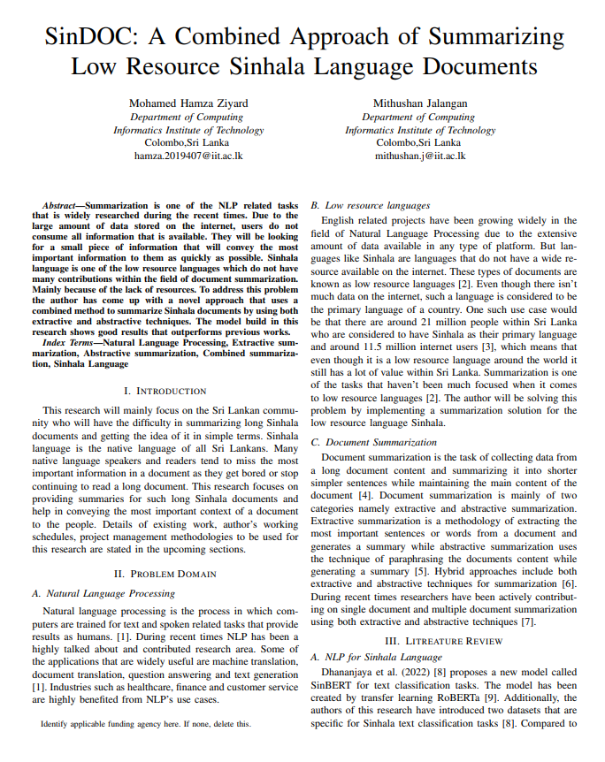
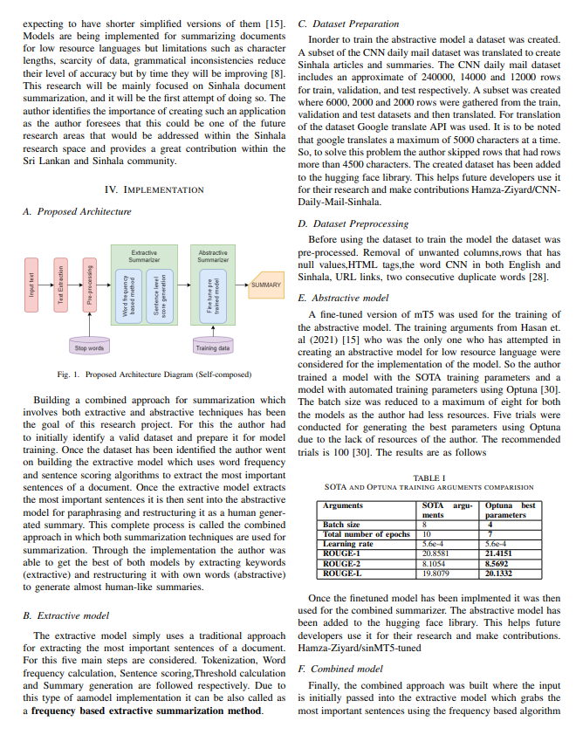
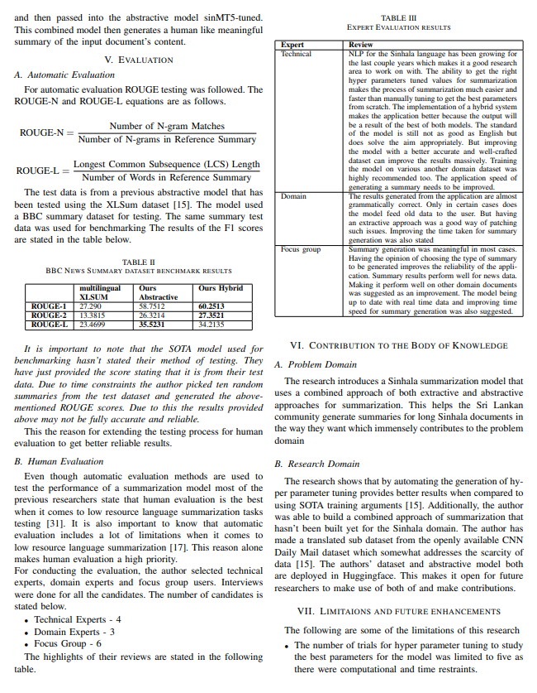
Research paper

Slide 31
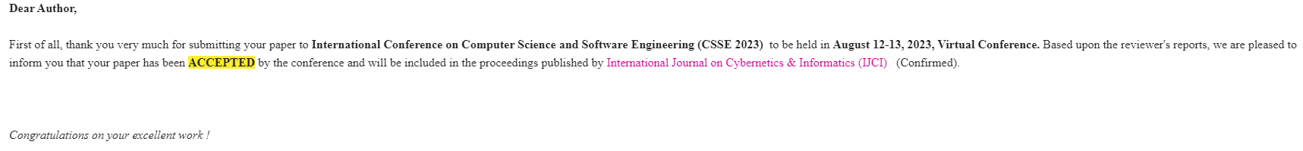
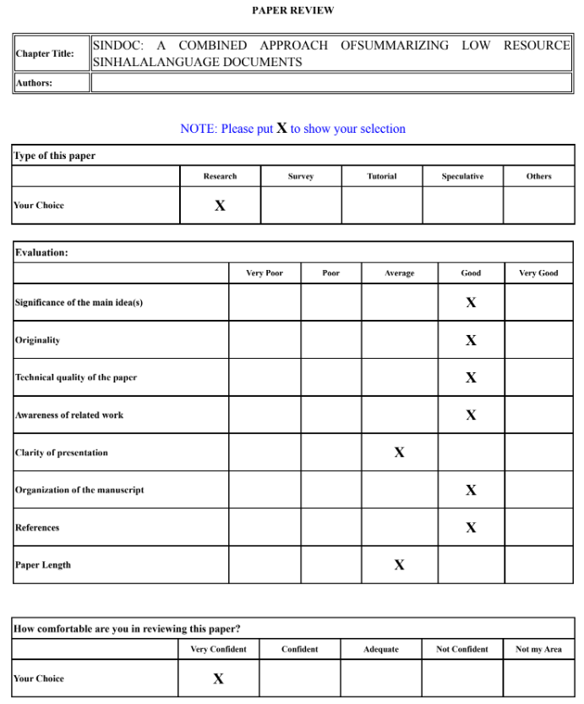
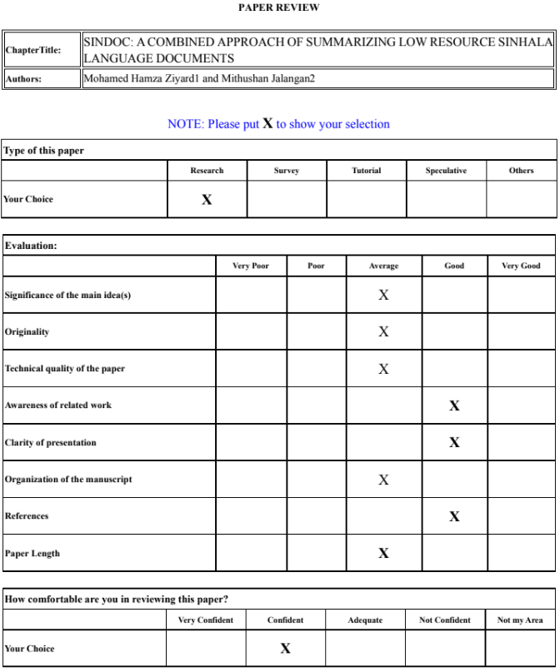
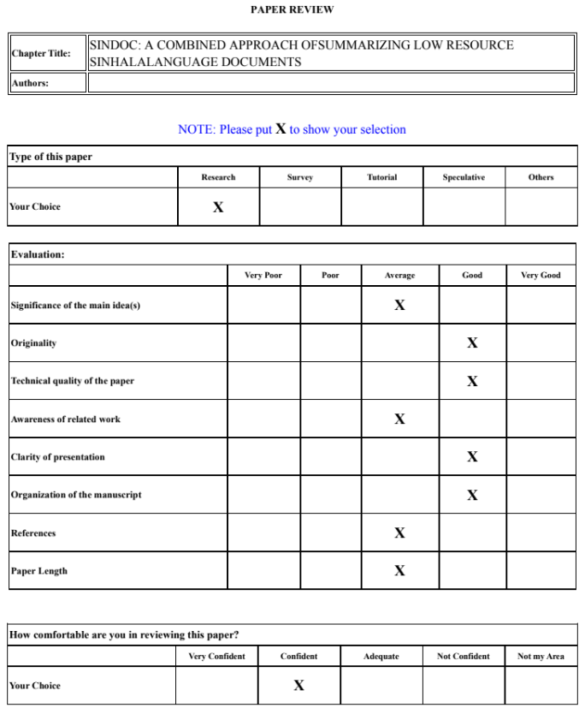
Acceptence proof I

Slide 32
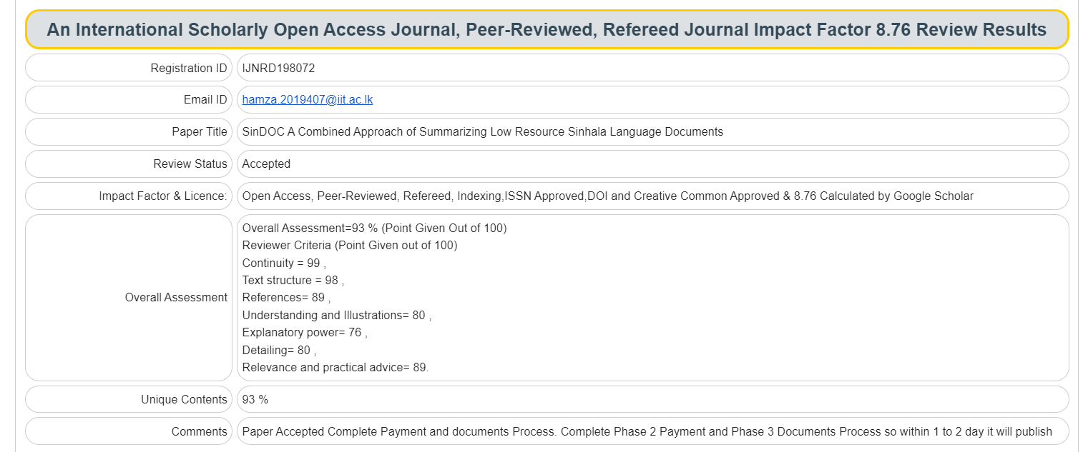
Acceptence proof II

Slide 33
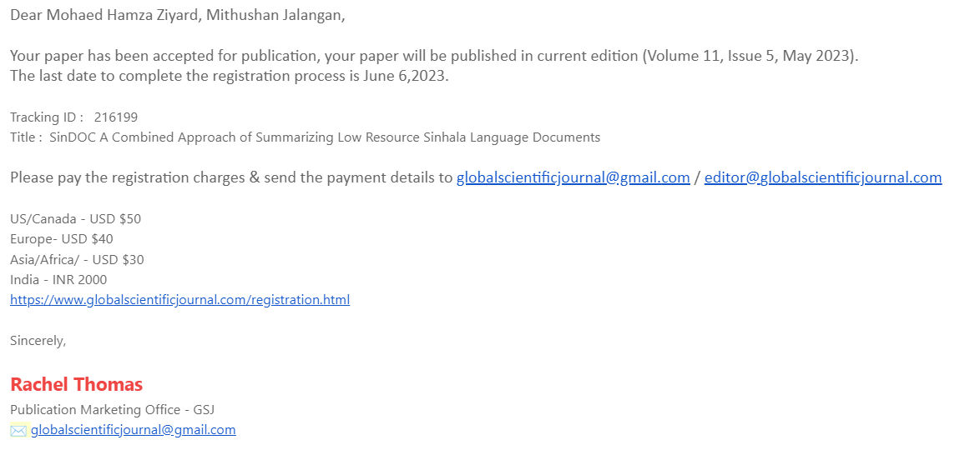
Acceptence proof III

Slide 34
Combined approach for summarization
Frequency based + Finetuned mT5
Primarily for Sinhala language
Introduction of a translated dataset
No input text limit
Publicly available on Huggingface and GitHub
SinDOC
Generating automatic training arguments for better results
Less researched area in Sinhala domain
Possibility of inaccurate automatic testing for LR languages
13 human evaluators
1 research paper

Slide 35
References
Hasan, T. et al. (2021). XL-Sum: Large-Scale Multilingual Abstractive Summarization for 44 Languages. Findings of the Association for Computational Linguistics: ACL-IJCNLP 2021. August 2021. Online: Association for Computational Linguistics, 4693–4703. Available from https://doi.org/10.18653/v1/2021.findings-acl.413
Gonçalves, L. (2021). Automatic Text Summarization with Machine Learning — An overview. luisfredgs. Available from https://medium.com/luisfredgs/automatic-text-summarizationwith-machine-learning-an-overview-68ded5717a25.
Dhananjaya, V. et al. (2022). BERTifying Sinhala -- A Comprehensive Analysis of Pre-trained Language Models for Sinhala Text Classification. 2022. arXiv. Available from https://doi.org/10.48550/ARXIV.2208.07864
Digital 2022: Sri Lanka. (2022). DataReportal – Global Digital Insights. Available from https://datareportal.com/reports/digital-2022-sri-lanka
Liu, Y. and Lapata, M. (2019). Text Summarization with Pretrained Encoders. Proceedings of the 2019 Conference on Empirical Methods in Natural Language Processing and the 9th International Joint Conference on Natural Language Processing (EMNLP-IJCNLP). November 2019. Hong Kong, China: Association for Computational Linguistics, 3730– 3740. Available from https://doi.org/10.18653/v1/D19-1387

Slide 36
References
Zhang, X., Wei, F. and Zhou, M. (2019). HIBERT: Document Level Pre-training of Hierarchical Bidirectional Transformers for Document Summarization. Available from http://arxiv.org/abs/1905.06566
Devlin, J. et al. (2019). BERT: Pre-training of Deep Bidirectional Transformers for Language Understanding. Proceedings of the 2019 Conference of the North American Chapter of the Association for Computational Linguistics: Human Language Technologies, Volume 1 (Long and Short Papers). June 2019. Minneapolis, Minnesota: Association for Computational Linguistics, 4171–4186. Available from https://doi.org/10.18653/v1/N19- 1423.
Subramanian, S. et al. (2020). On Extractive and Abstractive Neural Document Summarization with Transformer Language Models. Available from http://arxiv.org/abs/1909.03186

Slide 37
Thanks!
Any questions?
Mohamed Hamza Ziyard
Supervised by Mithushan Jalangan

